Slide 1
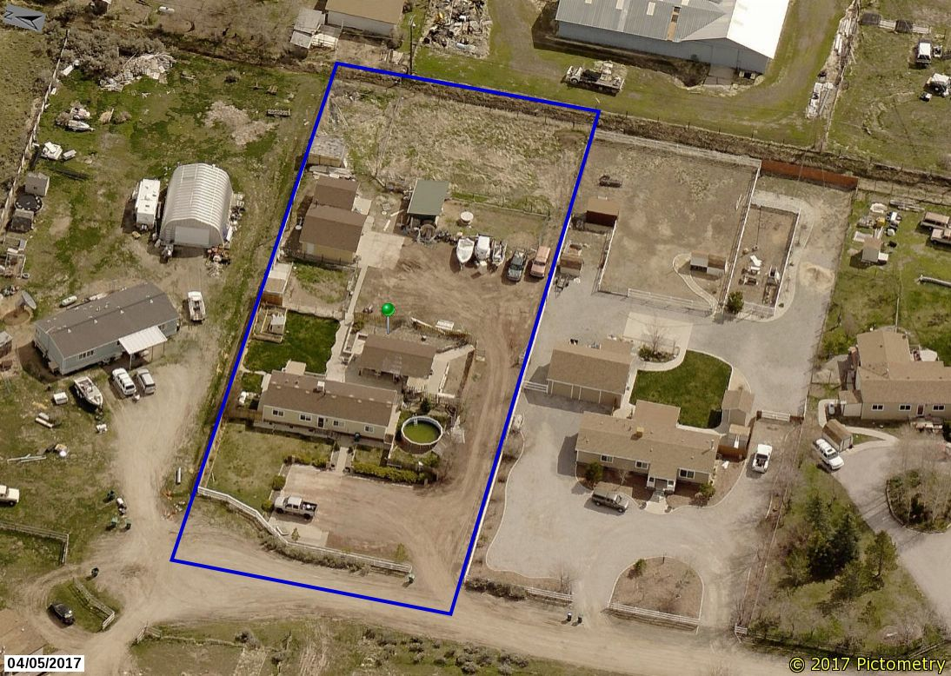
Washoe County Board of Adjustment
WVIO-PLA18-0379 (Hilbert Appeal)
October 3, 2019

Slide 2
Background/Overview
Code enforcement (CEO) staff and an Administrative Hearing Officer have both confirmed that a code violation exists on the subject property
The CEO determined violation by conducting a field investigation
The Hearing Officer confirmed violation at the conclusion of an administrative hearing
The property owner has appealed these findings per WCC Chapter 125, Administrative Enforcement Code

Slide 3
Background/Overview
Subject property is in “old” Cold Springs at 17690 Roper Ct.
1-acre property surrounded by similar 1-acre properties
Not rural – zoned Low Density Suburban (LDS), a residential zoning district

Slide 4
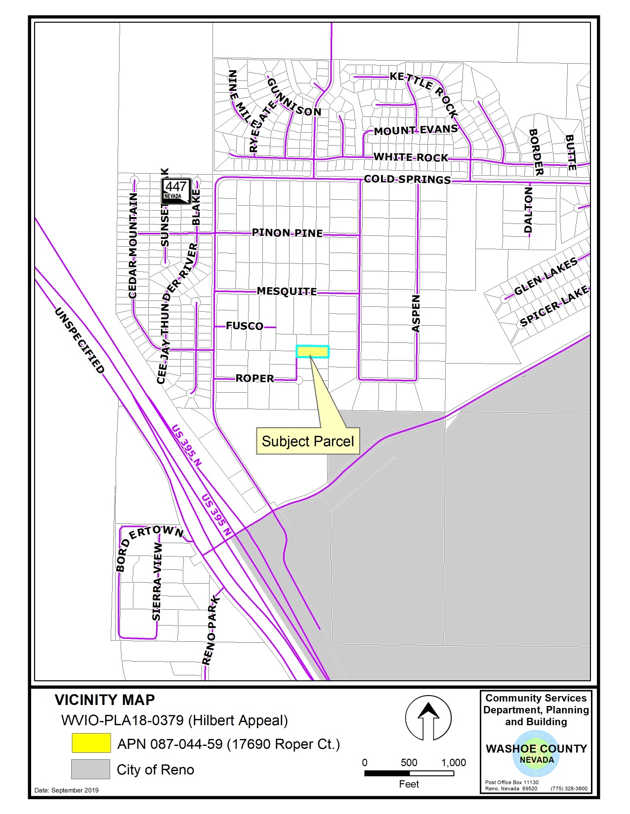

Slide 5
Background/Overview
Anonymous complaint received June 22, 2018 alleging the following was occurring at 17690 Roper Ct:
  That someone was living in a RV;
  Storage of unregistered RV’s; and,
  Commercial vehicles were being stored on the property
Upon investigation, the CEO confirmed that a commercial vehicle was visibly stored on the property
The other alleged violations were resolved
Anonymous complainant has continued to call staff weekly to check on the status of the case

Slide 6
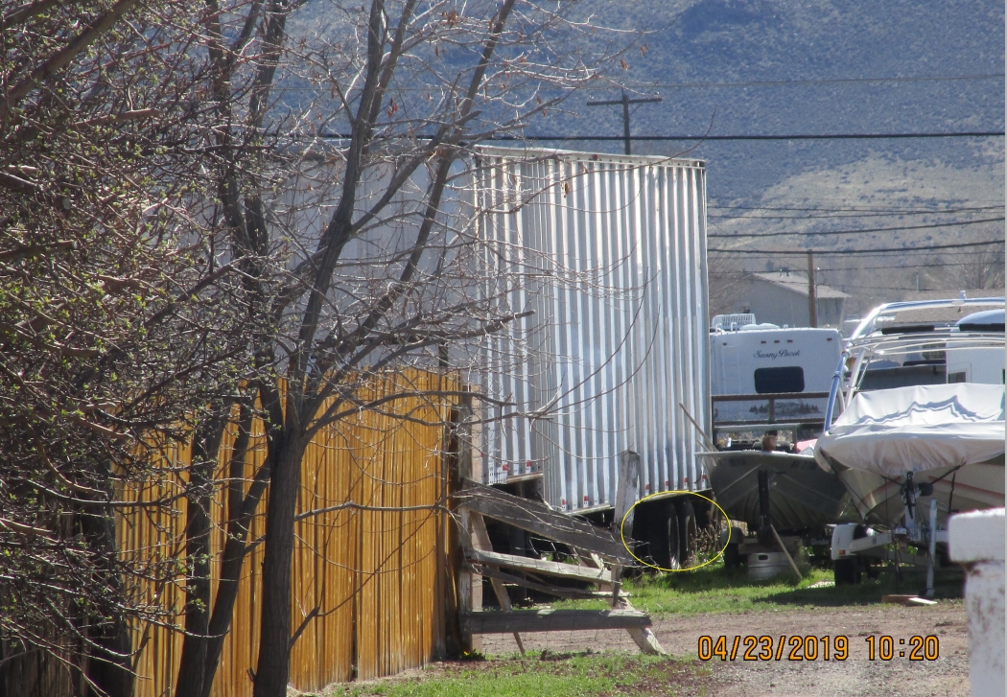
Background/Overview

Slide 7
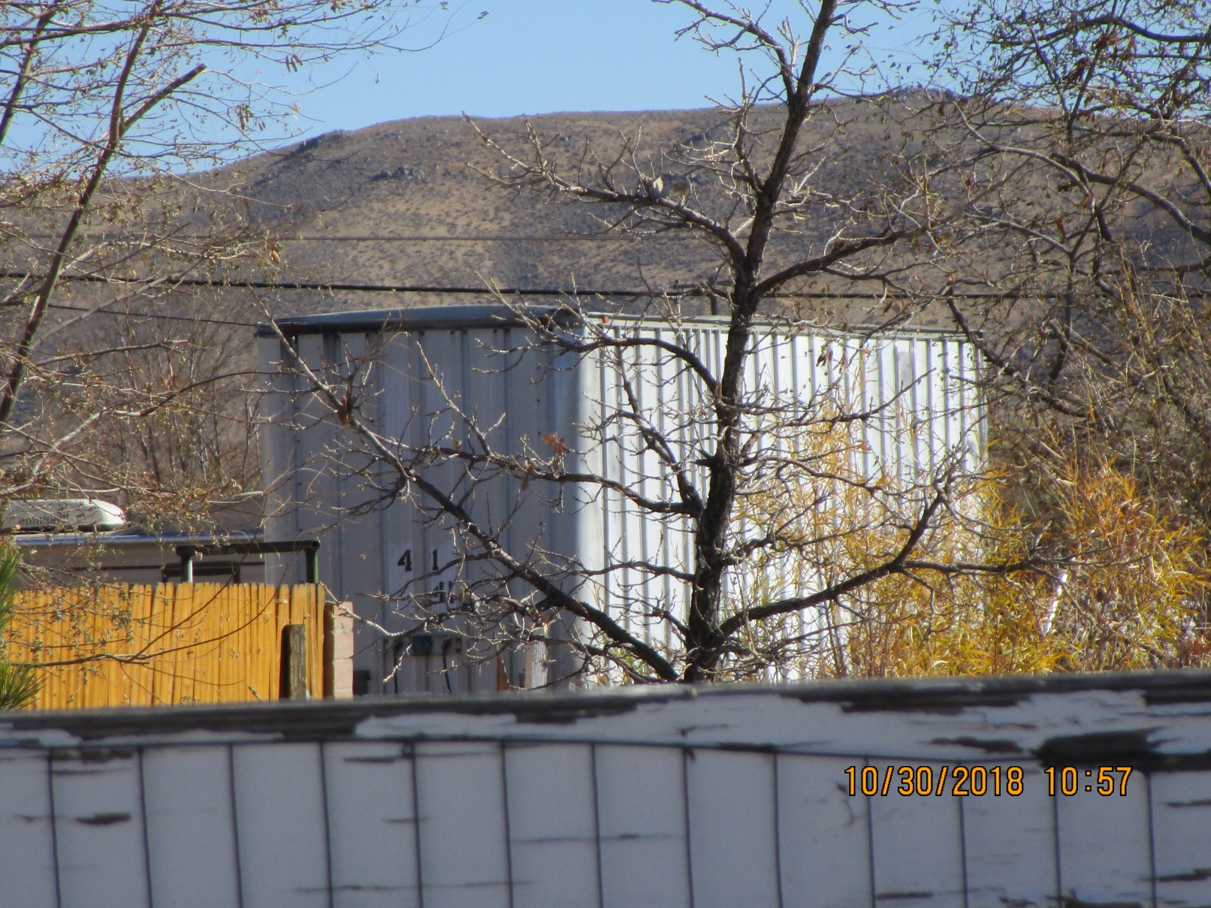
Background/Overview

Slide 8
Background/Overview
Violation of WCC 110.306.35(c), Outdoor storage of commercial vehicle(s) on a residentially zoned property (semi-trailer)
See background section of staff report for a detailed case timeline…some highlights:
County commissioner involvement – incorrect information provided by commissioner
Appealed 1st Penalty Notice on May 24, 2019; Administrative Hearing held on June 19, 2019

Slide 9
Background/Overview
Administrative Order issued requiring:
  Legalize placement by obtaining a building permit; or,
  Remove commercial vehicle by no later than August 20, 2019
Building Permit could not be obtained
Commercial vehicle not removed, but appeal filed on August 20 to the BOA
Proceedings stayed until disposition of BOA appeal hearing

Slide 10
Analysis
WCC Section 110.306.35(c) states that no storage of commercial vehicles shall be allowed on any residentially zoned parcel, unless specifically regulated in another section of the code
The 1 acre property zoned LDS is classified as a residentially zoned property
The subject vehicle is a commercial vehicle based on the definition provided by WCC 110.306.35(c)(1)
Exceptions to the storage of commercial vehicles are not applicable (e.g., not an RV)

Slide 11
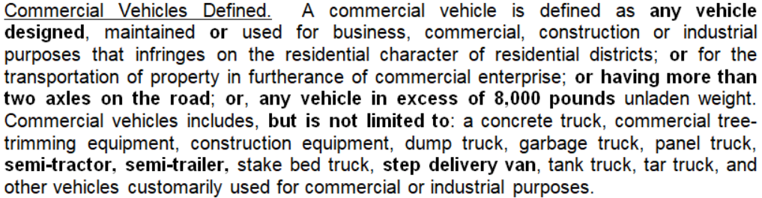
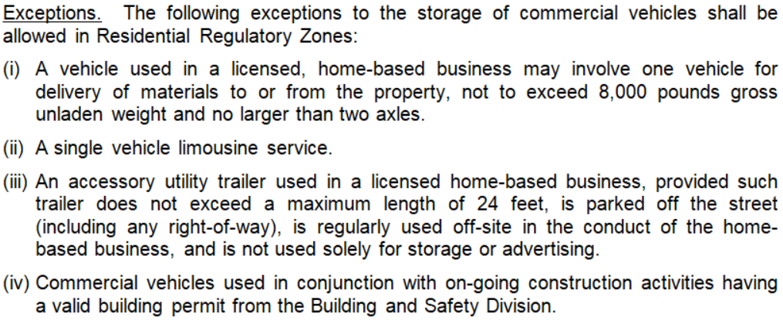
Analysis

Slide 12
Analysis
The appellant has not disputed the subject vehicle was purchased as a semi-trailer and towed to site
Rather, they have contended that they are allowed to have the semi-trailer based on approval from their county commissioner representing the area
Staff repeatedly informed the appellants this information was incorrect
The Administrative Hearing Officer, at hearing, also confirmed that a single county commissioner cannot make law and the semi-trailer violates adopted code

Slide 13
Analysis
The appellants then argued that the semi-trailer is no different than a cargo container and therefore should be allowed as an accessory use
But WCC has a very specific definition for a cargo container
The subject vehicle/semi-trailer does not meet that definition (regardless of whether or not the wheels are removed)
The semi-trailer has very different construction than a cargo container and was designed for “in-tow trailer” highway use

Slide 14
Analysis
110.902.15 Definitions:
Cargo Container. “Cargo Container” means an Intermodal Container, Sea-land Container, ISO Container, or Conex Box that is not designed for independent or “In-tow Trailer” highway use, and that was originally designed and constructed as a standardized, reusable storage and shipping vessel to be loaded on a truck, rail car or ship.

Slide 15
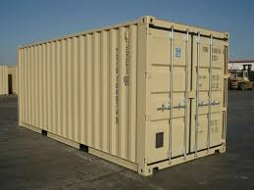
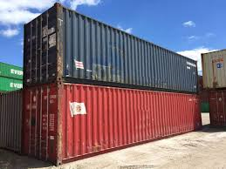
Analysis

Slide 16
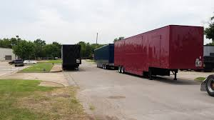
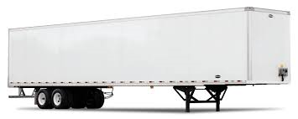
Analysis

Slide 17
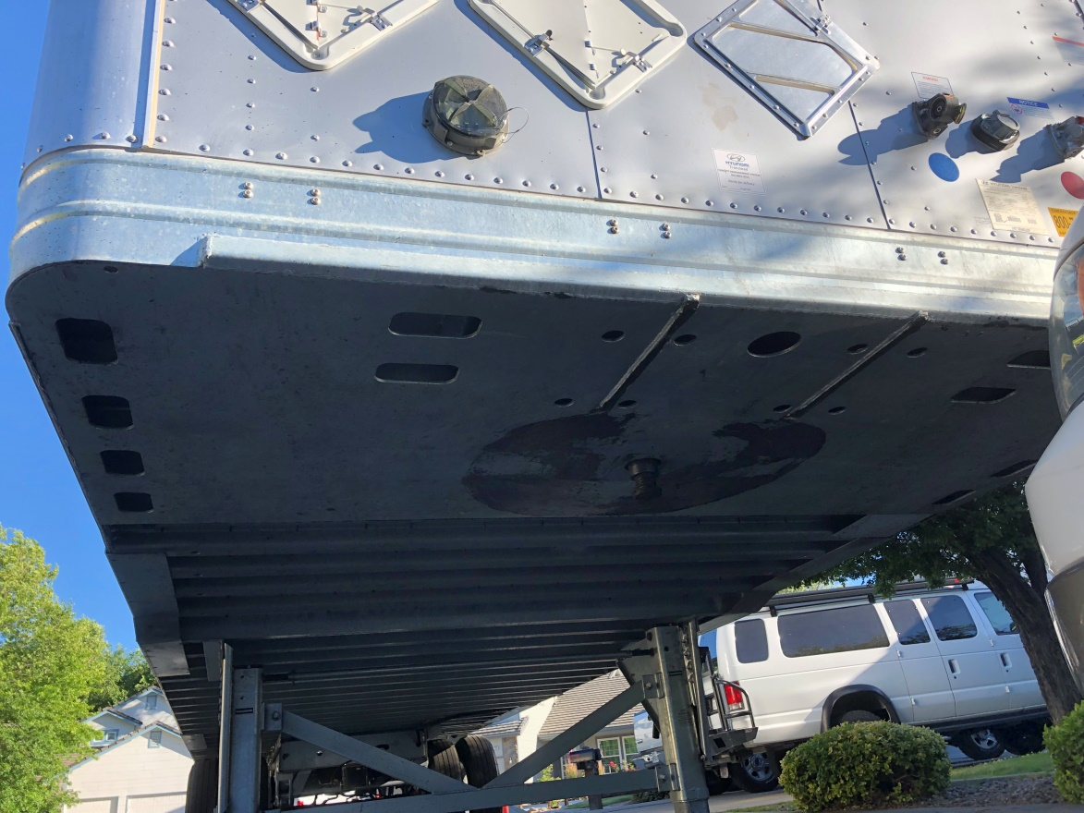
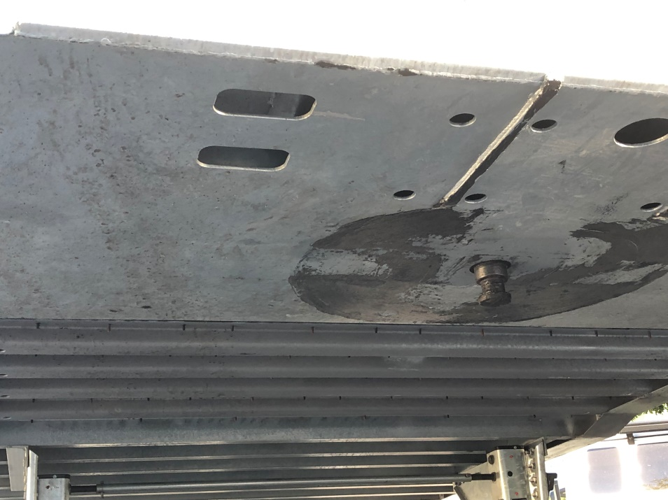
Analysis

Slide 18
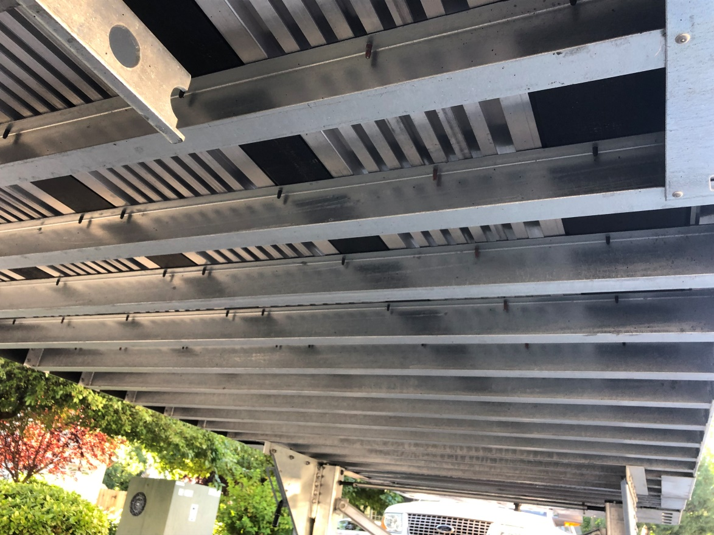
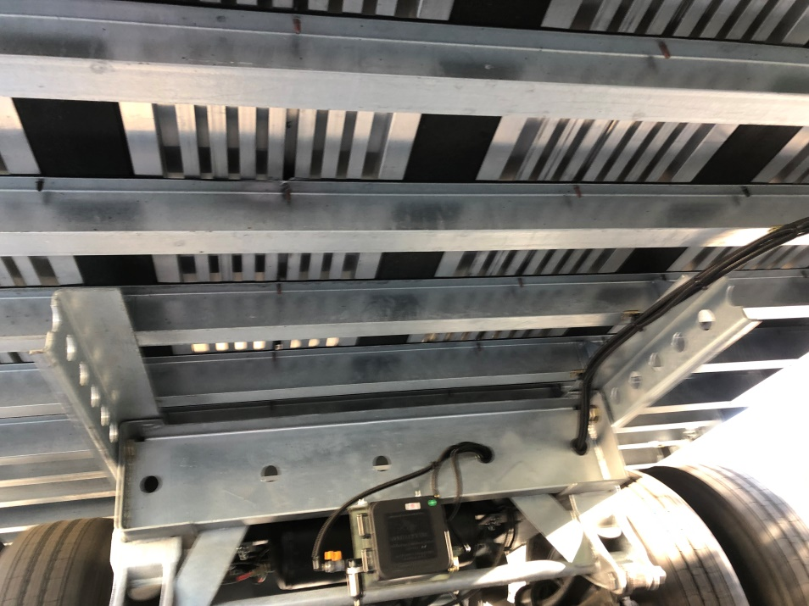
Analysis

Slide 19
Public Notice and CAB
Public notice is not required as part of an administrative enforcement action
Only noticing requirement is to notice the violator / appellant and provide due process
The appellant has been provided notice and due process as required by Chapter 125
CAB review and/or input is not part of an administrative enforcement action

Slide 20
Reviewing Agencies
No other agencies have been involved in this administrative enforcement action

Slide 21
Findings
The BOA is not required to make specific findings in reaching a decision on this appeal
Public record and body of evidence is sufficient
A written order of the BOA’s decision will be prepared, executed by the BOA Chair, and filed with the Secretary of the BOA
A copy of the order is served on the appellant
If the appeal is denied, the BOA should include in the written order / decision a compliance plan (e.g. remove the vehicle by x date)

Slide 22
Possible Motion
I move that, after giving reasoned consideration to the information contained in the staff report and information received during the public hearing, the Washoe County Board of Adjustment deny this appeal and uphold the decision of the administrative hearing officer that the appellant violated WCC Section 110.306.35(c), Outdoor storage of commercial vehicle(s) on a residentially zoned property; and, authorize the Chair of the Board of Adjustment to prepare a written order of the decision and file it with the Secretary of the Board of Adjustment, a copy of which shall be served to the appellant.

Slide 23
Appeal Process
The appellant has the right to appeal the written order by filing a petition for judicial review in the Second Judicial District Court for the State of Nevada within 25 days from the date the order is mailed to the appellant. Per WCC Section 110.910.15(i)(6), when a petition for judicial review is filed, the court rules shall govern the proceeding and the requested judicial review is in lieu of an appeal to the Board of County Commissioners as authorized by NRS 278.310(3)(b).

